Slide 1
Team 25:
Irving Cares
Josh Huang, Luke Finn, Austin Doremus, Michael Fadayomi, Jeremiah Dukes, Adam Duncan

Slide 2
01.
Summary

Slide 3
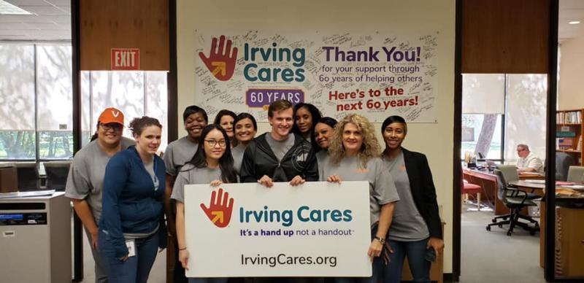

Overview of Irving Cares
Services:
Food Pantry
Emergency Assistance Program
Employment/Education Services
Mission:
Provide focused assistance for Irving residents to address a financial crisis
Vision:
To offer efficient and effective human services to Irving residents in need

Slide 4
02.
Business Problem

Slide 5
How to reach a greater quantity of potential donors
How to incentivize increased funding from current + future donors
How social media can be utilized to most effectively accomplish these goals

Slide 6
Problems to
Address
Understanding
Social Media Use
Maximizing
Irving Cares wanted to utilize this knowledge to generate more donors
As a byproduct, generate more funding
Establish long term presence on social media
Irving Cares wanted a greater understanding of their donor demographics
To gauge their preferences in social media platforms
Recognize financial situation
Ultimately, the main goal was to harness this info
To recognize the best platform to pursue
In addition to the approach for posting content

Slide 7
03.
Solution

Slide 8
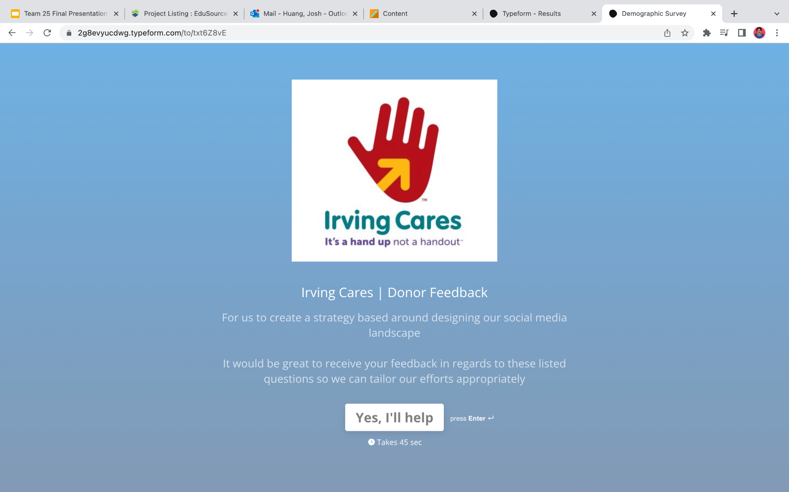
Solution (Part 1)
Create a survey
Address the core questions at hand
Receive valuable information on the areas of focus

Slide 9
Demographics

Slide 10
Socials/Services

Slide 11

Relevant Data
$75K
Female
Married
Minimum household income from about 63% of respondents
The gender that was reported by over 71% of respondents
Reported marital status of over 61% of respondents

Slide 12
Key Data for Social Media
Facebook
56-76
Food Pantry & Education/Employment
Age group that represented about 61% of total respondents
The most important services to respondents
Most common social media platform used by respondents

Slide 13
Narrow
Narrow our focus after receiving feedback
Ensure
Ensure our approach considered the needs of our demographic
Simplify
Simplify the process of change due to the average donor being older
Solution (Part 2)

Slide 14
04.
Recommendations

Slide 15

Recommendations
Maximize the platforms with highest existing users
Reduce struggles with transitioning to a new platform
Overall, emphasize high familiarity and comfort
Focus on Facebook/Instagram
Create short-form content
Tailor Content
Create meaningful content that reflects their values
Announcements and showcases of services
Overall, help incentivize/motivate donors
A more interactive way to deliver info
Helps with reducing low retention
Easier to digest for target demographic

Slide 16
05.
Projected Impact

Slide 17
Long - Term Projected Impact
Testing Phase
Gather Feedback
Adjustments
Do a test run to observe the initial reaction to the new content format
After launching the new campaign, consider another survey or questionnaire
Adjust/make changes based on feedback where needed
Finalize
Expanding
Sustaining
With the new adjustments, Irving Cares can fully launch the campaign
Create a plan to potentially use other services such as YouTube or TikTok to attract more demographics
Try to brainstorm a comprehensive plan for Irving Cares to follow long term

Slide 18
Post Project Actions
TikTok
Use TikTok as a platform for introductions of staff/services
Posting Schedule
Discussed plan for maximizing engagement with timing of posts
Additional Feedback
Create a new survey to gather more specific info about social media usage/habits

Slide 19
06.
Obstacles

Slide 20
Obstacles
Some of our biggest challenges early on involved coordination
Members typically had busy schedules and trying to set up meeting times with Irving Cares became difficult
- We utilized email as a method of maintaining some level of contact
- Irving Cares reciprocated feedback to guide our decision making
To help overcome our delayed progress, we took the initiative to begin creating a survey that would be delivered to the existing donors

Slide 21
07.
Lessons Learned/Meaning

Slide 22
Lessons Learned
Coordination
Ability to navigate/adapt to busy schedules
Proactive Approach
Take command in situations when not prompted
Clear/effective communication
Being transparent about our situations and clarifying any confusion/misunderstandings
Resilience
Staying composed despite challenges

Slide 23
Impact on Irving Cares
For Irving Cares, this project has been an opportunity for us to help with amplifying their message
We seek to create a social media presence that allows them to diversify their content, but retain their core values
Ultimately, we hope our efforts will help generate a sense of newfound energy for their clients.

Slide 24
Meaning for Group
This project has been an opportunity for us to focus primarily on the human aspect of social work
From both within our group and in relation to our work with Irving Cares, we have realized the importance of empathy
Overall, the project has shown us the value of everyone's unique perspective

Slide 25
08.
Questions?

